Slide 1

COMP8790 | Topics: Applied Artificial Intelligence
Exploring the Causes of the STEM Gender Disparity
Team Composition:
MEET PATEL
ABHISHEK SOLANKI
PALAK DESAI
HARSHKUMAR SABHAYA
PRIYAL PATEL

Slide 2
Outline
Problem Introduction and Motivation
Hypothesis
Approach
Demo
Experiments
Results
Discussion
Conclusion
References

Slide 3
Problem Introduction and Motivation
Introduction
In recent years, women’s under-representation in science, technology, engineering, and math (STEM) fields has gained widespread attention in public, academic, and policy circles.
Beyond being a barrier to the equality and justice of our society, this marginalization is becoming problematic from a strategic point of view too: many of the world’s most pressing challenges require interdisciplinary solutions rooted in STEM, to which women would bring new perspectives and approaches.
Motivation
To help address this increased demand, widespread efforts have encouraged women’s participation in STEM fields (e.g., the Girls Who Code organization); although notable, such efforts would be support by an awareness of the backgrounds, characteristics, and personality traits of students who choose these paths to begin with.
This project aims to exploit simulated data to understand the interplay between these factors and possibly bring new insights to light.

Slide 4
Hypothesis
We hypothesize that various background characteristics and personality traits shape men's and women's plans to enroll in STEM majors in different ways and amounts.
Specifically, we expect that factors such as personality traits, social influences, family influence and media bias play significant roles in influencing these decisions.
Understanding these factors can help develop targeted interventions to encourage more women to pursue STEM careers.

Slide 5
Approach
Model Description
An agent-based modeling approach was chosen to gather insights into the impact of an individual’s environment on their decisions.
Each agent represents a person with attributes such as gender, personality traits (Openness, Conscientiousness, Extraversion, Agreeableness, Neuroticism), a math score, interests (Art, Social, Science), and whether they have chosen a STEM career.
Simulation Details
Agents go through two main states: growing up and adulthood.
In the growing up phase, agents attend school, socialize, exchange interests, and develop their math score.
In adulthood, agents choose a career, select a long-term partner, and eventually reproduce.
The simulation considers factors like media bias and social influence to model real-world dynamics.

Slide 6
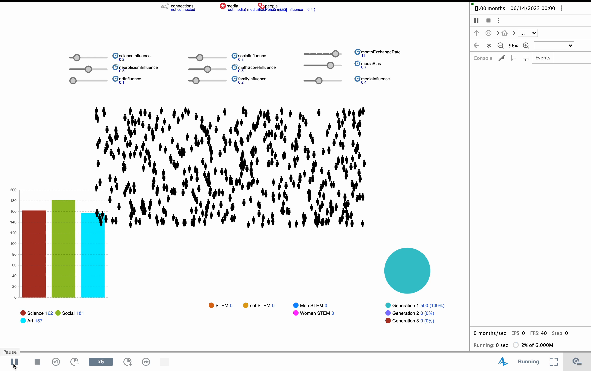
Demo

Slide 7
Experiments
The model was run multiple times with different combinations of parameters to assess the effects of changes.
Parameters varied include:
Social Influence (0.1, 0.4, 0.7)
Math Score Influence (0.1, 0.4, 0.7)
Neuroticism Influence (0.1, 0.4, 0.7)
Month Exchange Rate (6, 9, 12)
Media Bias (0.5, 0.7, 0.9)
Rationale
These parameters were chosen based on their identified significance in motivating both gender gap and the decision to pursue a STEM major in general.
They are also parameters on which it appears more realistic to intervene.

Slide 8
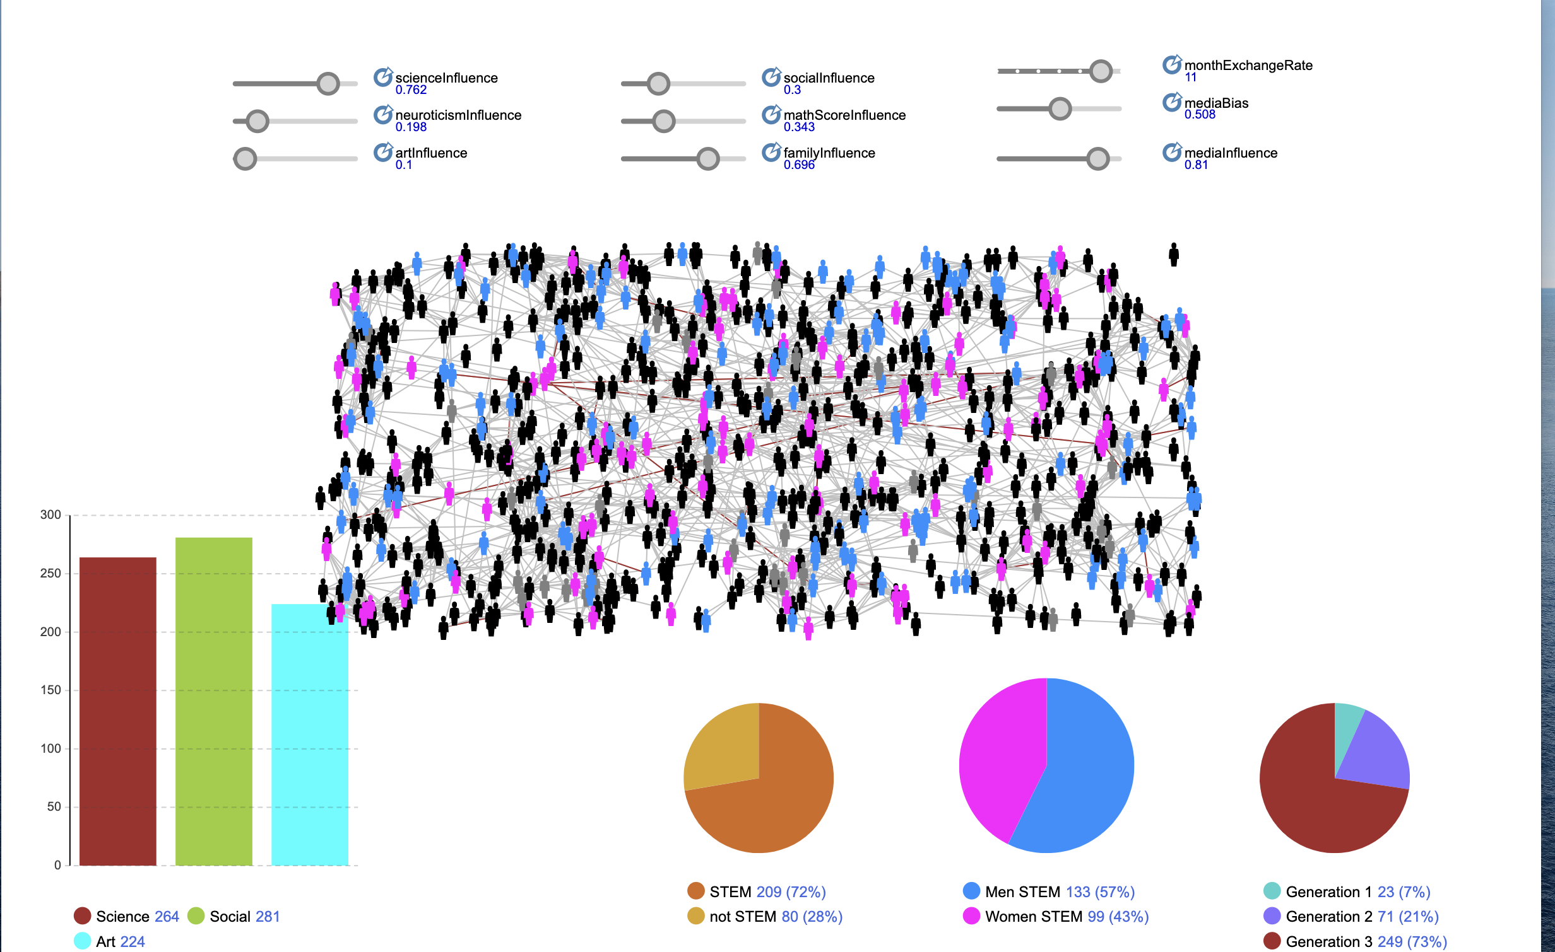
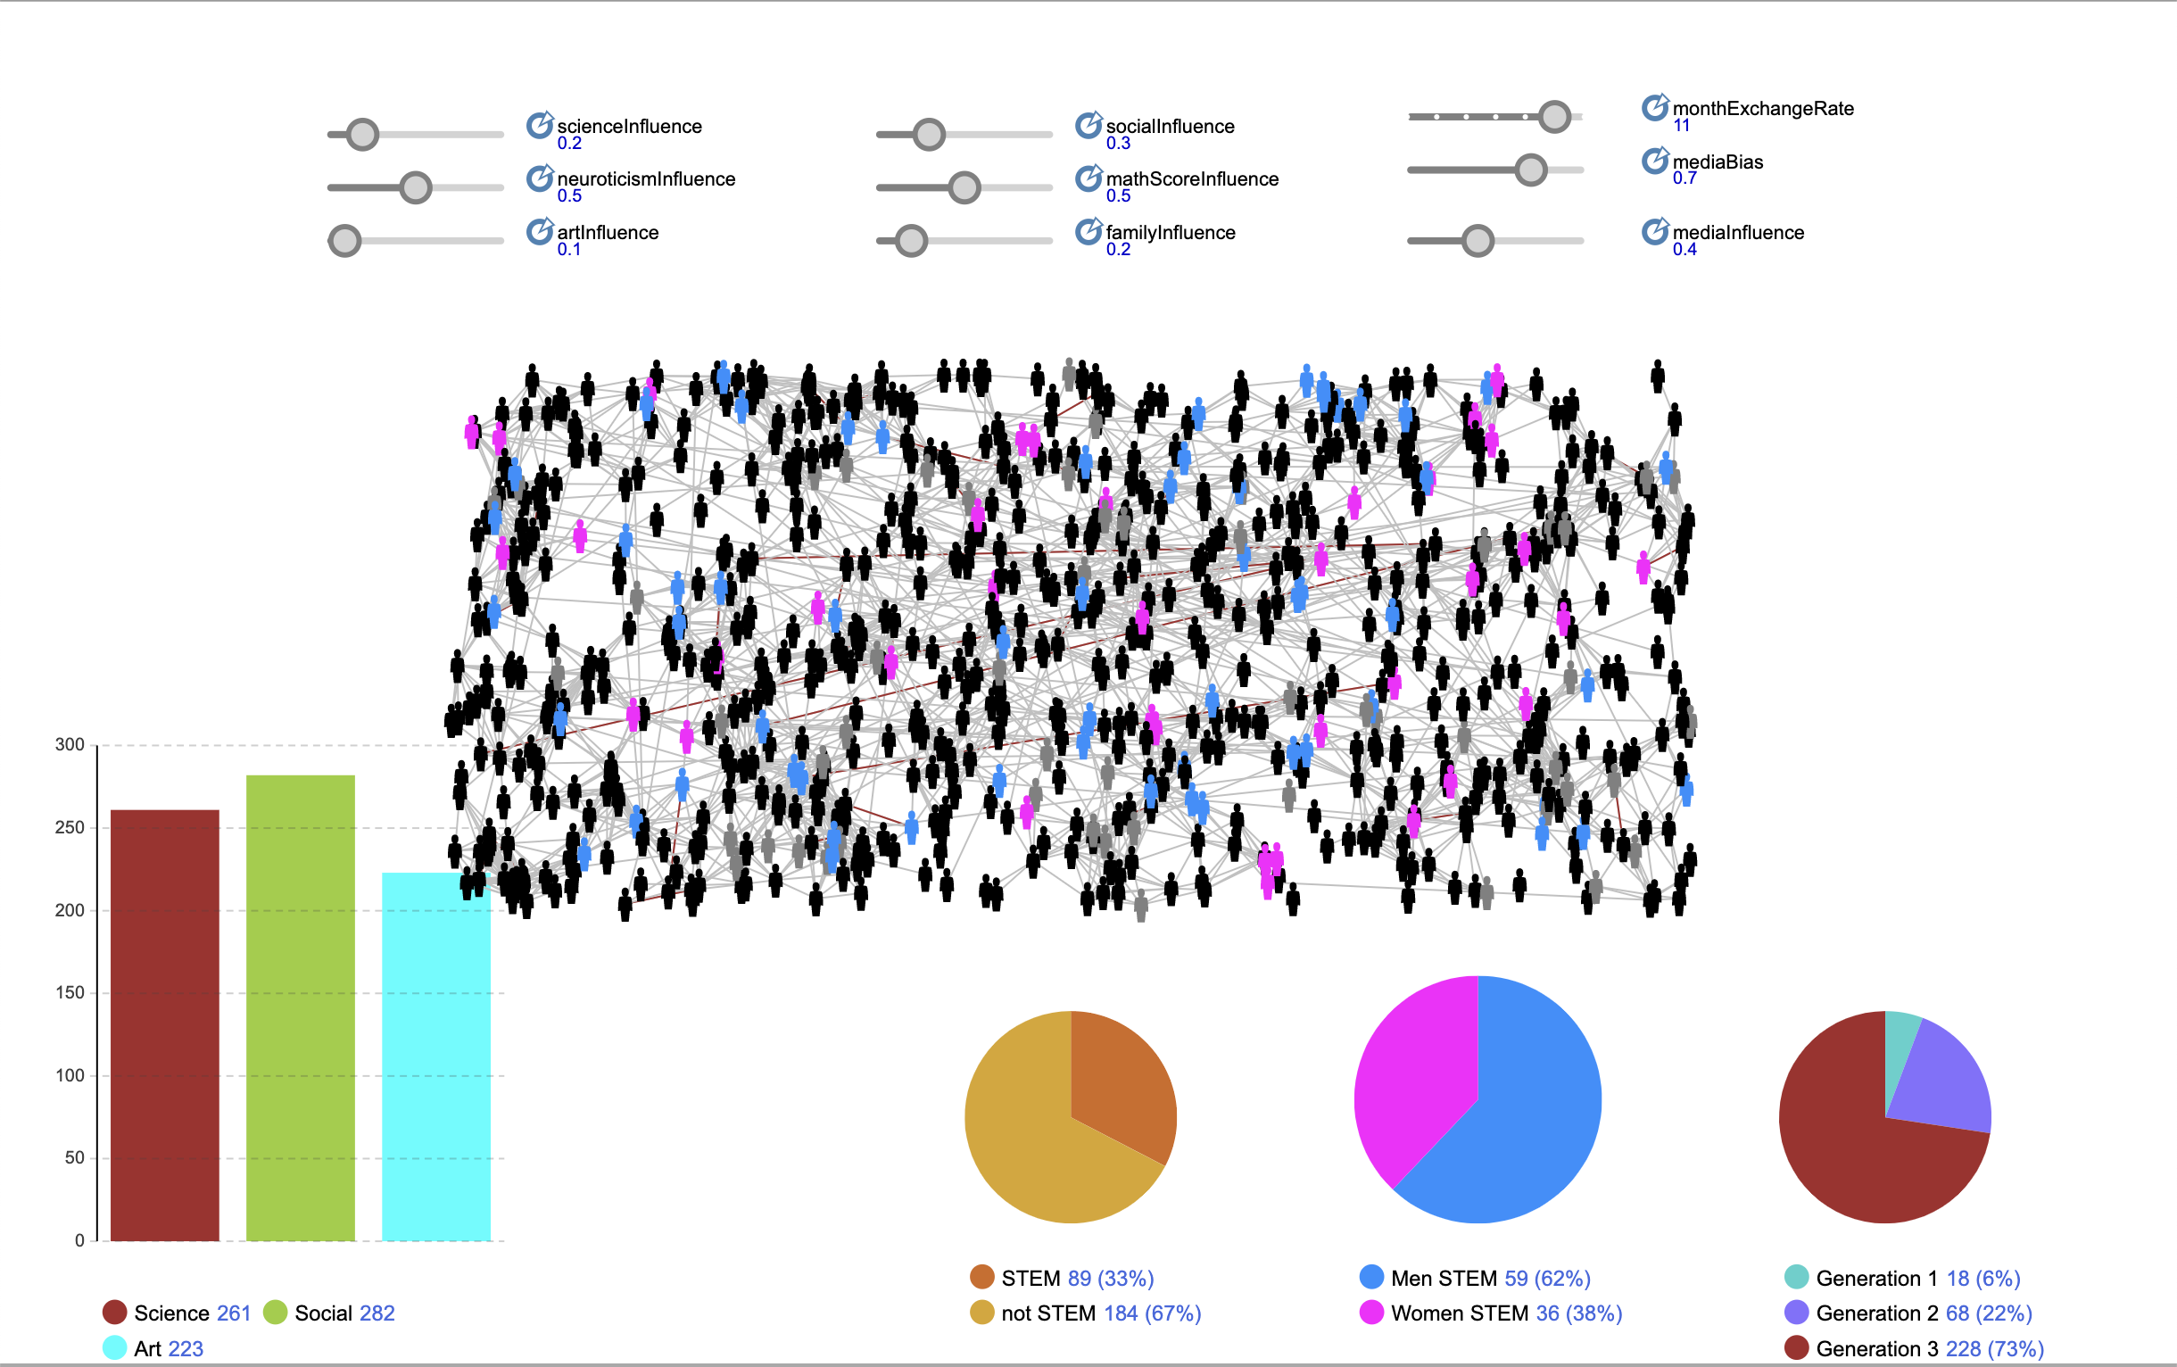
Results
The average percentage of women choosing STEM careers across all simulations is 38%.
Media influence plays a significant role in the gender disparity in the STEM field.
Family influence is a determining factor for individuals of all genders in pursuing STEM careers.

Slide 9
Discussion
Analysis
Media bias significantly influences the gender gap by affecting the interests of agents.
Social influences and family influences also play critical roles.
The simulation underscores the importance of role models and targeted interventions to reduce the gender gap.
Limitations
Simplifications in the model, such as binarizing personality traits and reducing the influence of childhood and parental factors.
Assumptions made regarding the probabilities of certain traits and influences.

Slide 10
Conclusion
Summary
The simulation provides valuable insights into the factors contributing to the gender gap in STEM fields. Media bias, social influences, and personality traits are crucial in shaping career decisions.
Interventions
To reduce the gender gap, interventions could focus on promoting female role models in STEM, addressing media biases, and fostering environments that build confidence in math abilities for women.
Future Research
Further research could refine the model to include more nuanced factors, such as detailed childhood influences and varying parental impact.

Slide 11
References
González-Pérez, S., Mateos de Cabo, R., & Sáinz, M. (2020). Girls in STEM: Is it a female role-model thing?. Frontiers in psychology, 11, 564148
Bullinaria, J. (2018). Agent-based models of gender inequalities in career progression. Journal of Artificial Societies and Social Simulation, 21(3).
Friedmann, E. (2018). Increasing women’s participation in the STEM industry: A first step for developing a social marketing strategy. Journal of social marketing, 8(4), 442-460.
Wang, N., Tan, A. L., Zhou, X., Liu, K., Zeng, F., & Xiang, J. (2023). Gender differences in high school students’ interest in STEM careers: a multi-group comparison based on structural equation model. International Journal of STEM Education, 10(1), 59.
Merayo, N., & Ayuso, A. (2023). Analysis of barriers, supports and gender gap in the choice of STEM studies in secondary education. International Journal of Technology and Design Education, 33(4), 1471-1498.
Tandrayen-Ragoobur, V., & Gokulsing, D. (2021). Gender gap in STEM education and career choices: what matters?. Journal of Applied Research in Higher Education, 14(3), 1021-1040.
Cimpian, J. R., Kim, T. H., & McDermott, Z. T. (2020). Understanding persistent gender gaps in STEM. Science, 368(6497), 1317-1319.
Card, D., & Payne, A. A. (2021). High school choices and the gender gap in STEM. Economic Inquiry, 59(1), 9-28.

Slide 12

Thank you

Slide 13

Any Questions?

